Slide 1

Lituania Alicea Bernard
5 de febrero de 2015
GREEN-PR
Notes:
Hello, we are all working with different projects but today we are going to focus in a very special place in the heart of San Juan Metropolitan area, the Martin Peña Channel. I work with Proyecto ENLACE del Caño Martín Peña.
I’m Cindy and
I am Keisha, and we are part of EDRA.

Slide 2
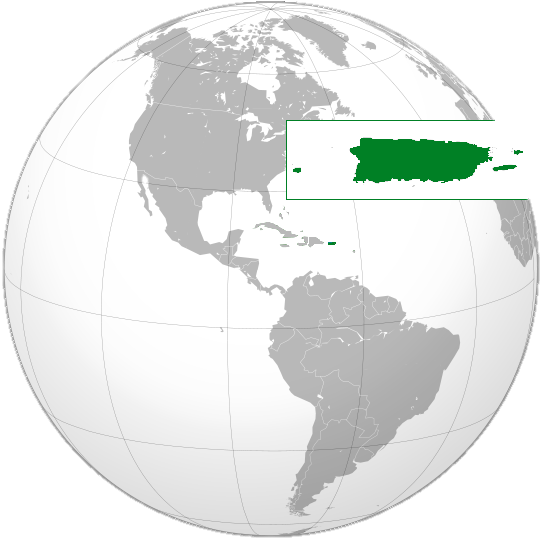
Notes:
For those of you who might not know exactly were Puerto Rico is. We are a small island in the middle of the Caribbean.

Slide 3
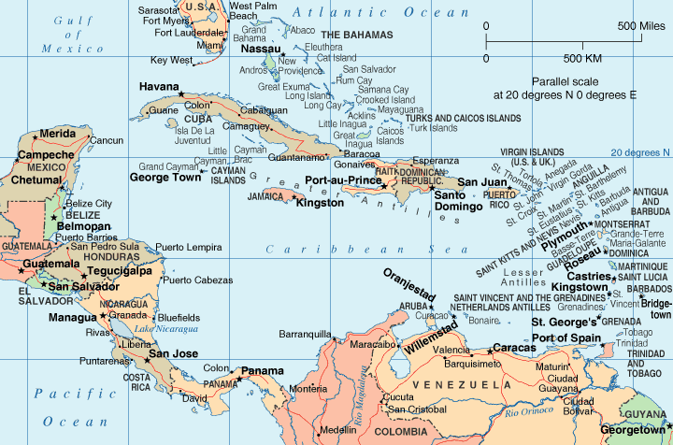
Notes:
Here you can see a zoom of our island in he region.

Slide 4
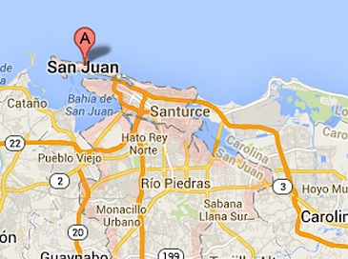
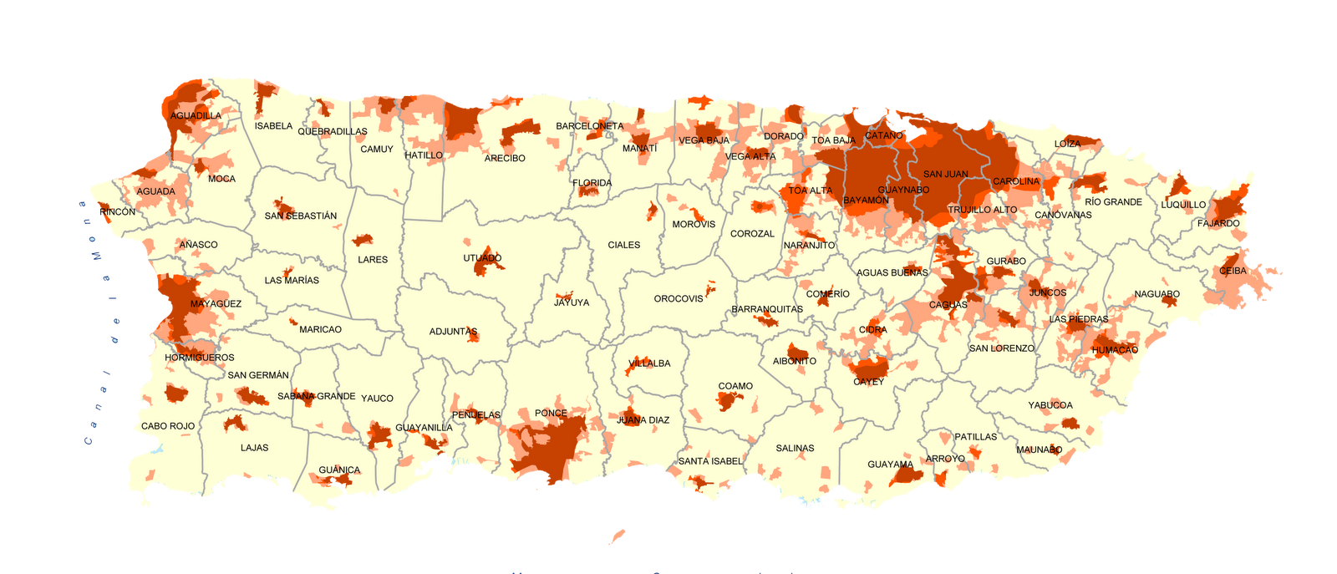
Notes:
Zooming in even further we are working in San Juan, our vegetables garden are located in the area of ​​Santurce. And now a closer look into the Martin Peña Channel Special District.

Slide 5
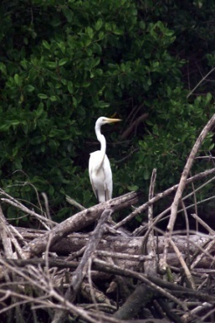
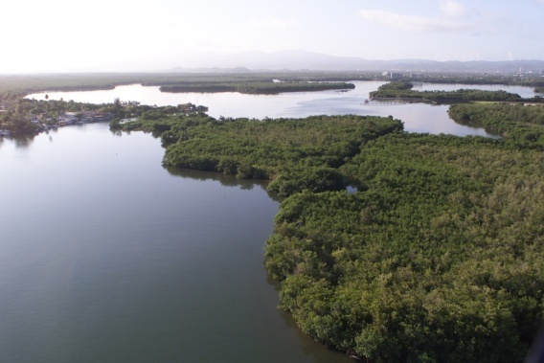
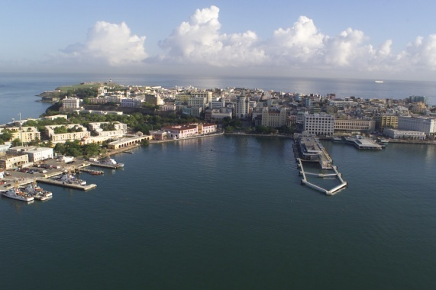
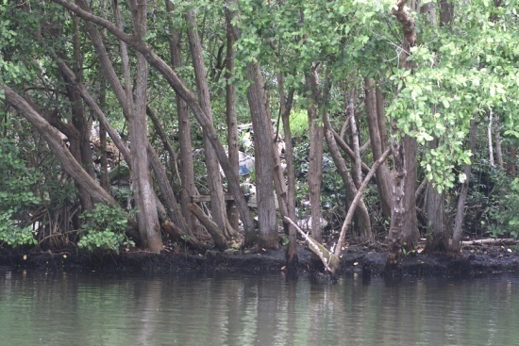
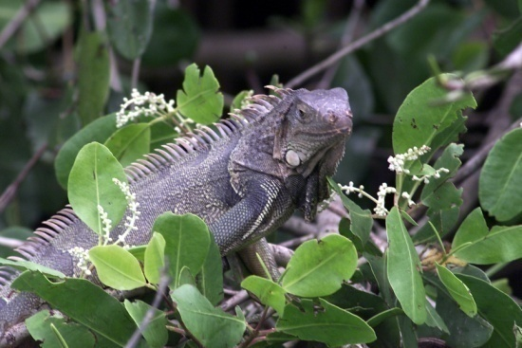
San Juan Bay Estuary
Condado Lagoon
Piñones Lagoon
Los Corozos Lagoon
San Antonio Canal
Torrecillas Lagoon
San Juan Bay
Suárez Canal
San José Lagoon
Caño Martín Peña:
Length 3.75 millas (6km)
Notes:
The Martín Peña Channel is part of Estuary System San Juan Bay, arguably the most important ecological resource of the Metropolitan Area. The estuary consists of a series of lagoons, swamps and interconnected channels, with three outlets to the sea, from Toa Baja to Loiza. It is a very important ecologically, but with the problem that the Caño Martín Peña is clogged. Its as if an important artery of your heart was clogged, what would happen?

Slide 6
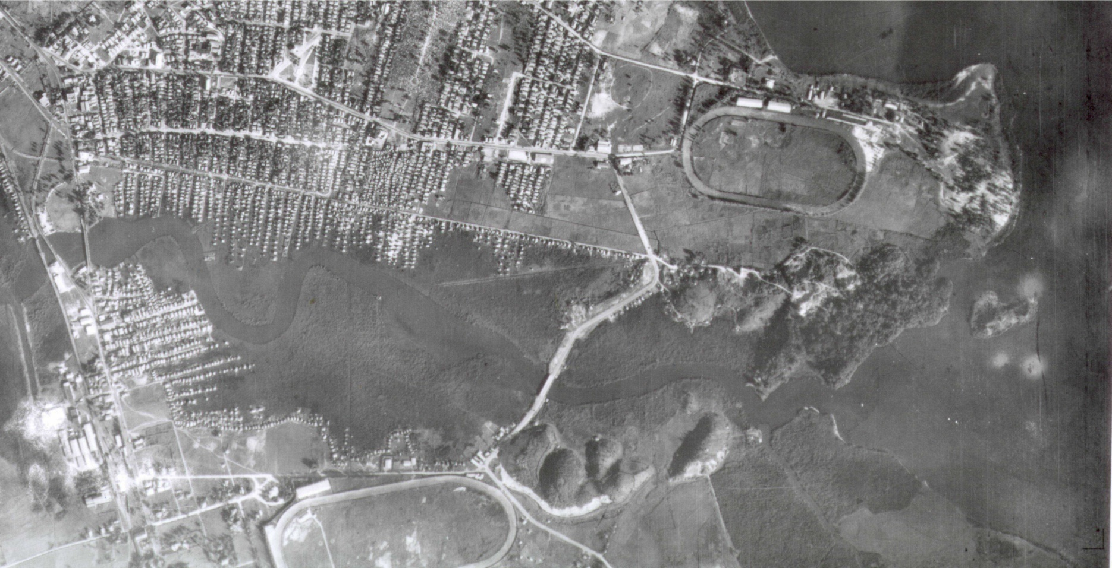
1936
Notes:
In the 40’s with industrialization people started moving from rural areas of Puerto Rico to San Juan, creating these dense communities by settling sometimes with help of the goverment in the mangrove forests surrounding the Channel. Goverment though mangrove to be dirty and unsanitary, now we know its an important part of our system, protects us from hurracaines and flooding.

Slide 7
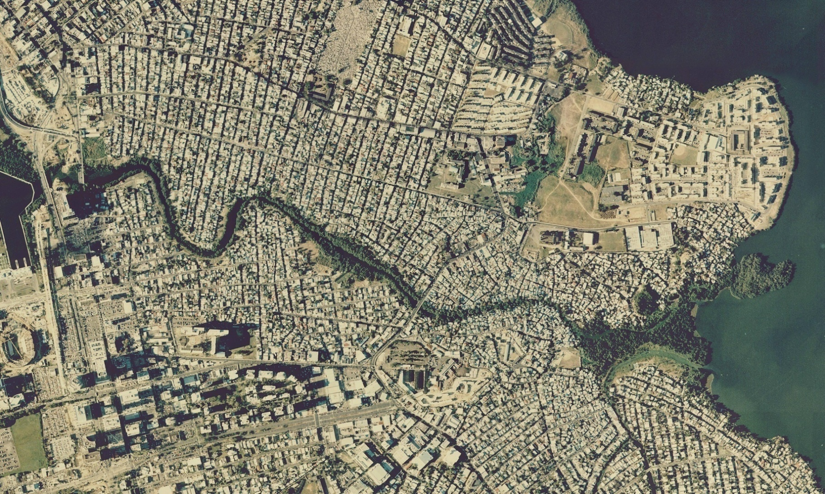
2000
Notes:
This is a more recent picture, were we can see the Caño is already clogged. People settled on top of the mangrove. Areas that used to measure between 100-200 feet wide, now measure 5-10 feet wide.

Slide 8
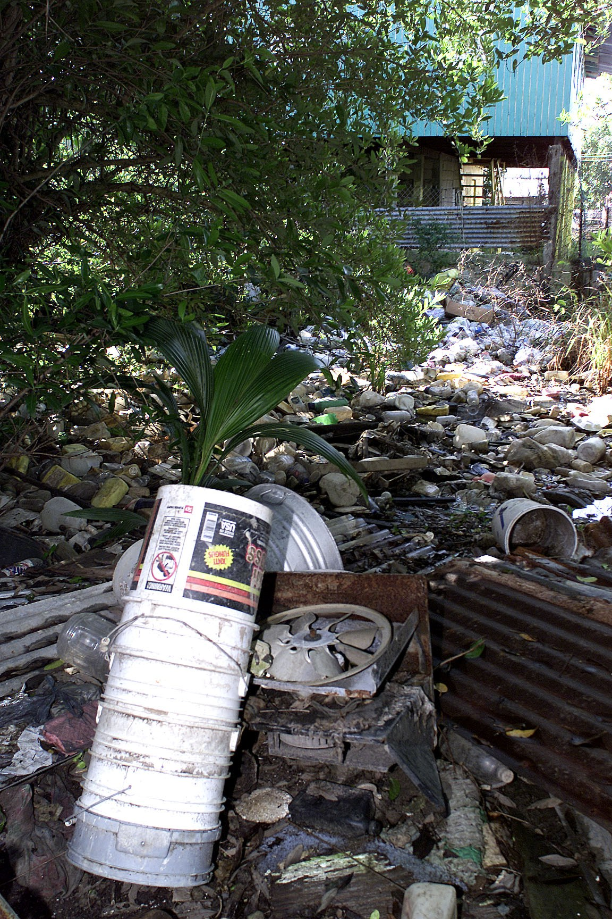
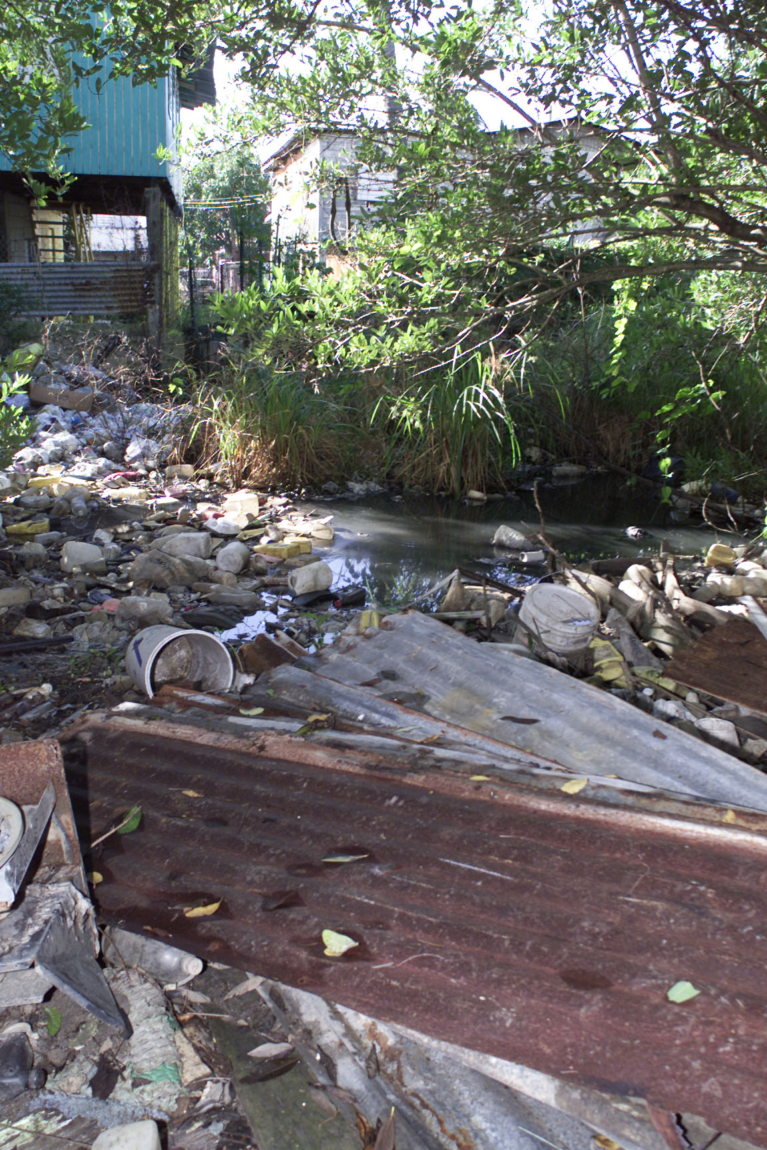
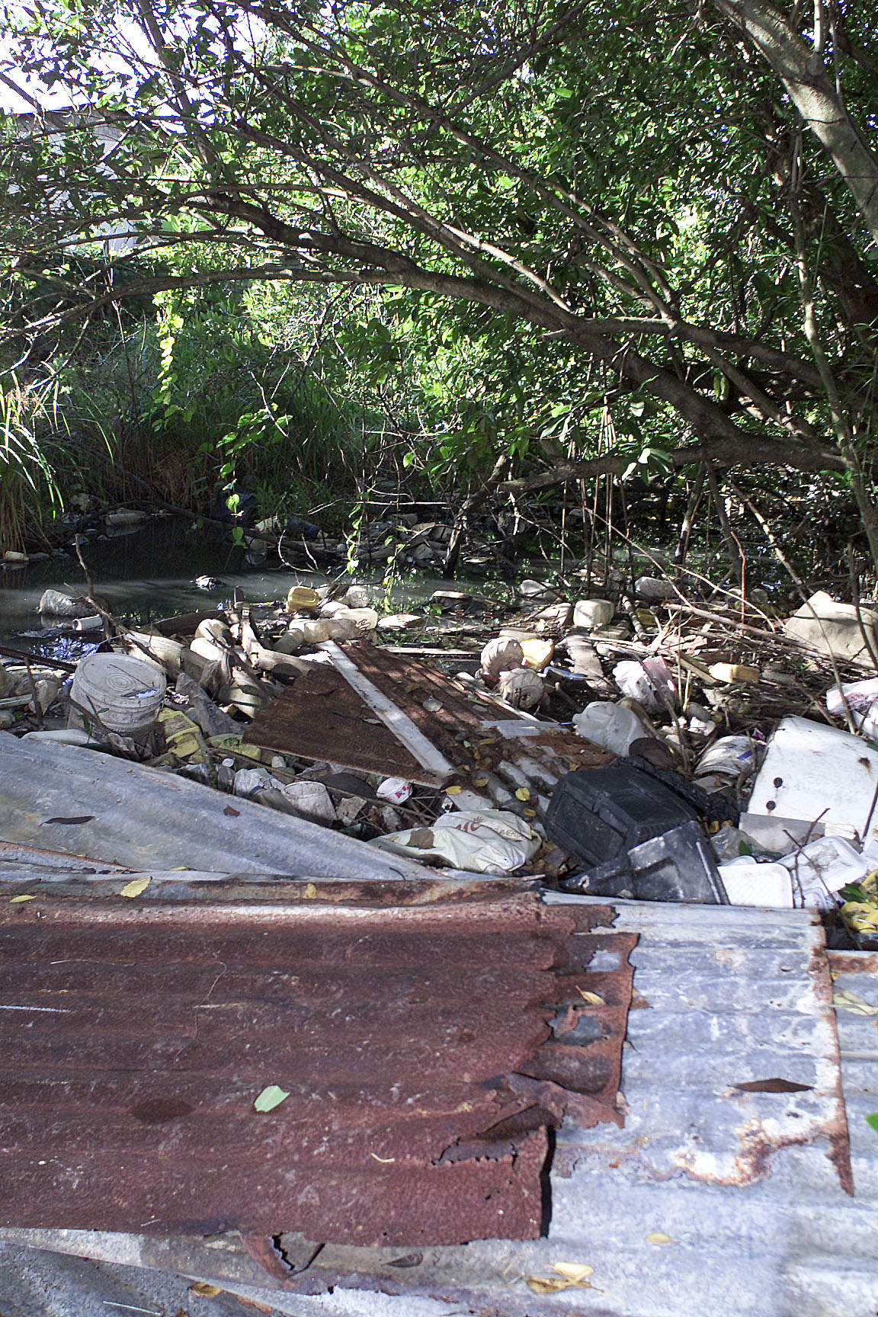
Notes:
Now you can even cross by foot from one side to the other. Families used to learn how to swim, had boats even that they would use in the channel, but this is how parts of it look now.

Slide 9
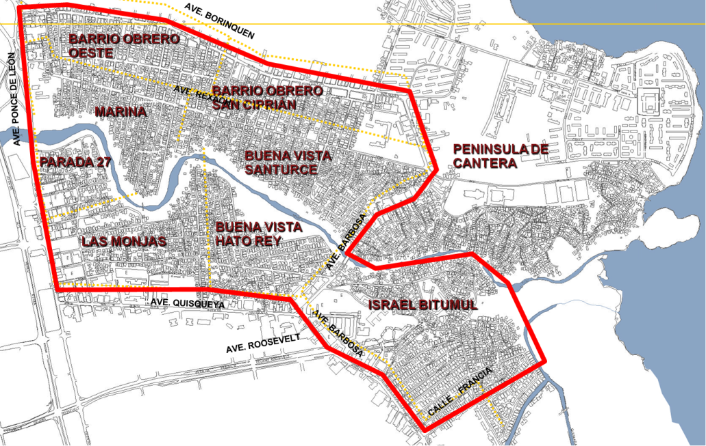
Notes:
We are eight communities, surrounding the channel.

Slide 10
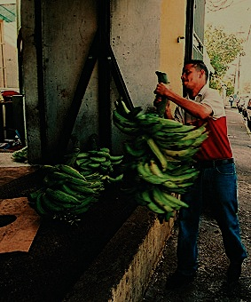
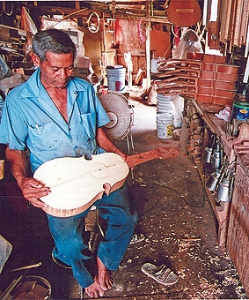
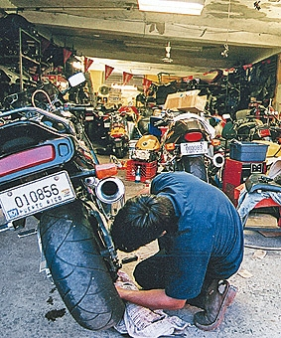
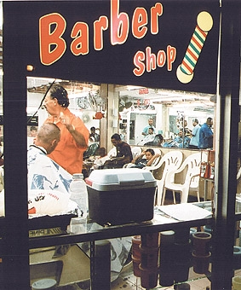
Indicadores socioeconómicos
65% de los hogares viven bajo nivel de pobresa
48% rdelos residentes completaron el 9 grado
23,000 residentes en las 8 comunidades
Notes:
Although the rates of participation in the labor force and employment are higher than in the rest of Puerto Rico, the percentage of families with income below poverty levels is higher than that of San Juan and the rest of the Island.
Sobre 23,00 habitantes de ocho comunidades habitan en los márgenes del Caño.
Aunque hay una alta proporción de inquilinos, el sentido de pertenencia y la cohesión comunitaria son características sobresalientes de estas comunidades.
23,097 inhabitants in impact area: eight inner city communities (squatter settlements)
Density: 28,300 inhabitants/square mile
48% housing units occupied by renters; in 1995, 73% of the population lived in the same address
Education: 48% of the population reached the ninth grade.
55% of households have income below $10,000/year. 65% of households live under poverty level; 25% unemployment
Residents in six communities lack land tenure
48% de la población tiene un nivel educativo menos a noveno grado
El 65% de los hogares está bajo el nivel de pobreza.
Y uno de los problemas que más preocupa a los residentes es la falta de títulos de propiedad.

Slide 11
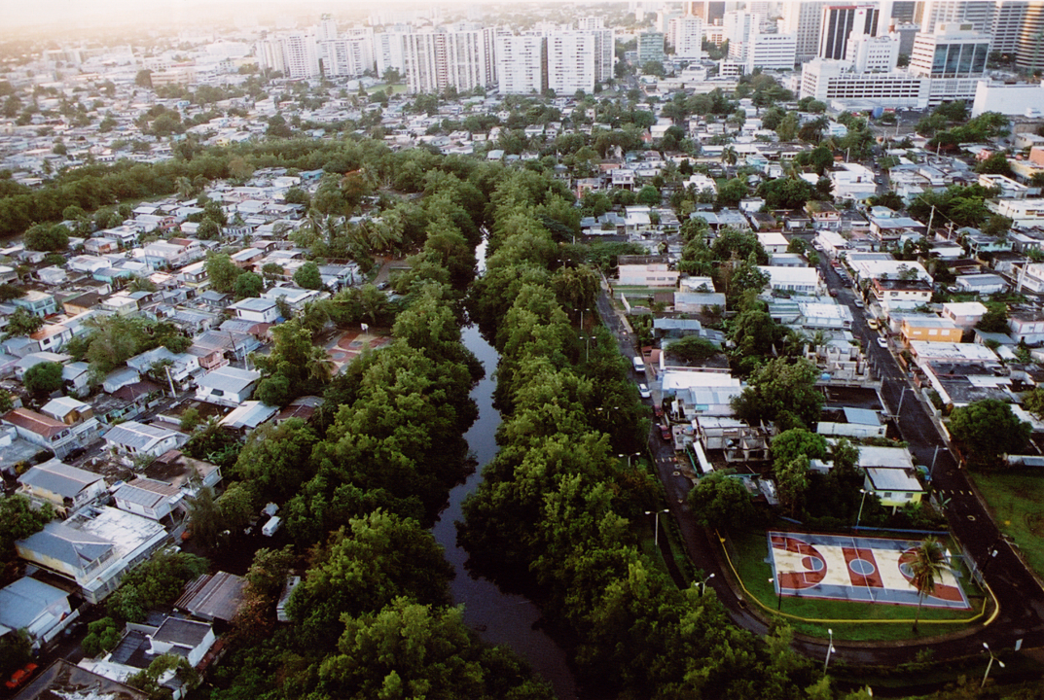
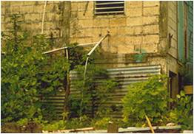
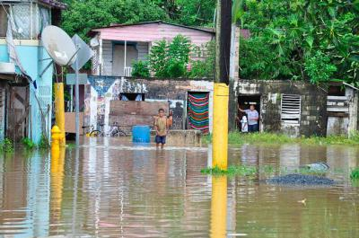
3,000 casas arrojan sus desperdicios al caño
39% de los hogares reportan desde1-20 inundaciones al año
Flooding
Fuente: Plan de Desarrollo Integral y Usos del Terreno para el Distrito de Planificación Especial del Caño Martín Peña y Programa del Estuario de la Bahía de San Juan, 2004.

Slide 12
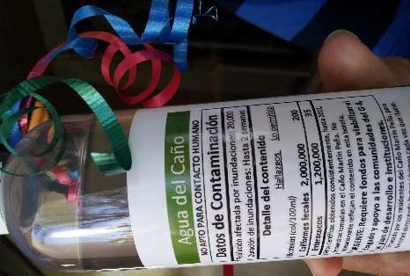
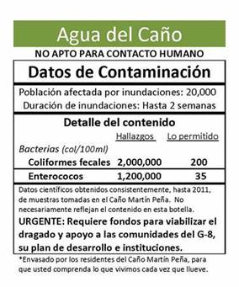
INDICADORES DE CONTAMINACION:

Slide 13
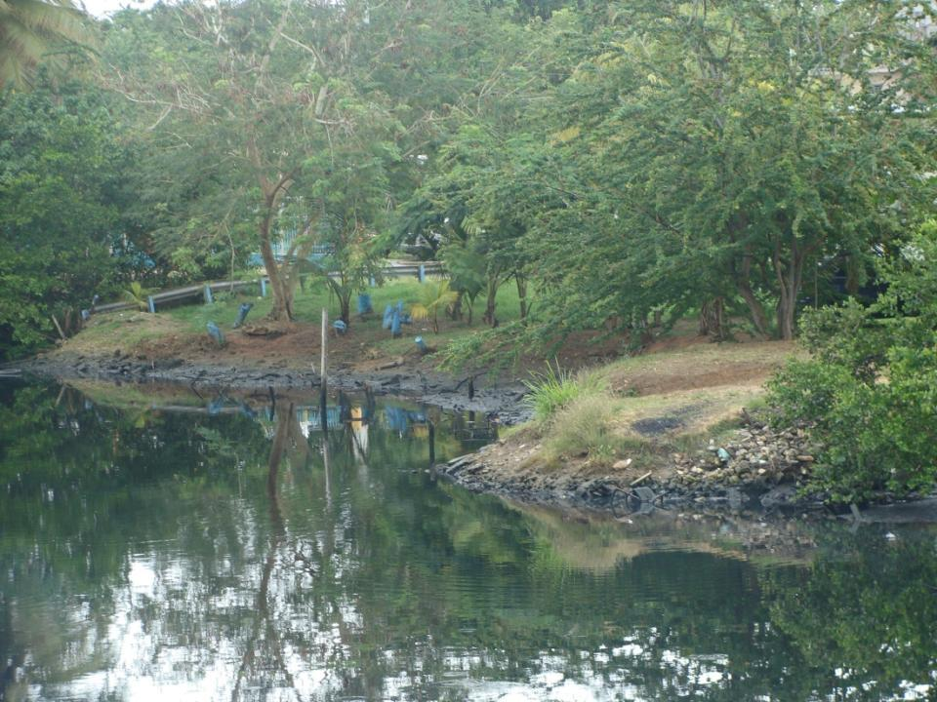
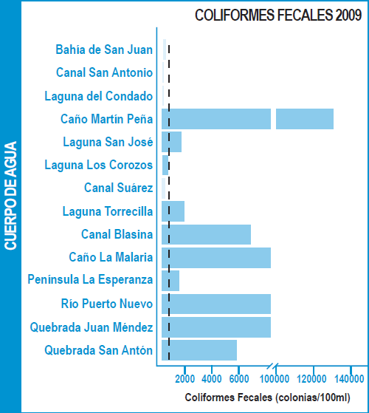
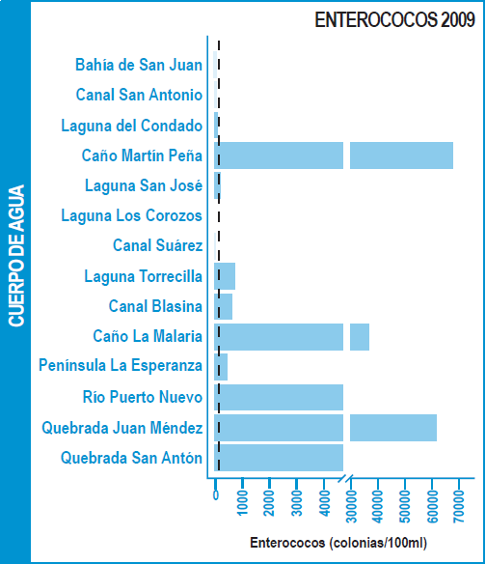
Muestras de agua del estuario de San Juan
Fuente: Bauza, J. (2010). Programa Estuario de la Bahia de San Juan

Slide 14
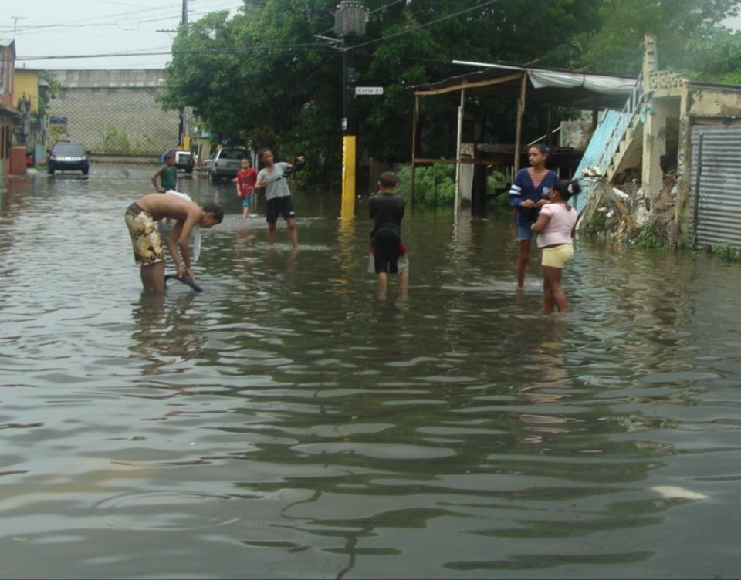
EFECTOS A LA SALUD
Enfermedades de la piel
Enfermedades
gastrointestinales
enfermedades
Infecciones
dermatitis
Por contacto:
Hepatitis A
Leptospirosis (ratas)
Dengue
nauseas y fiebre

Slide 15
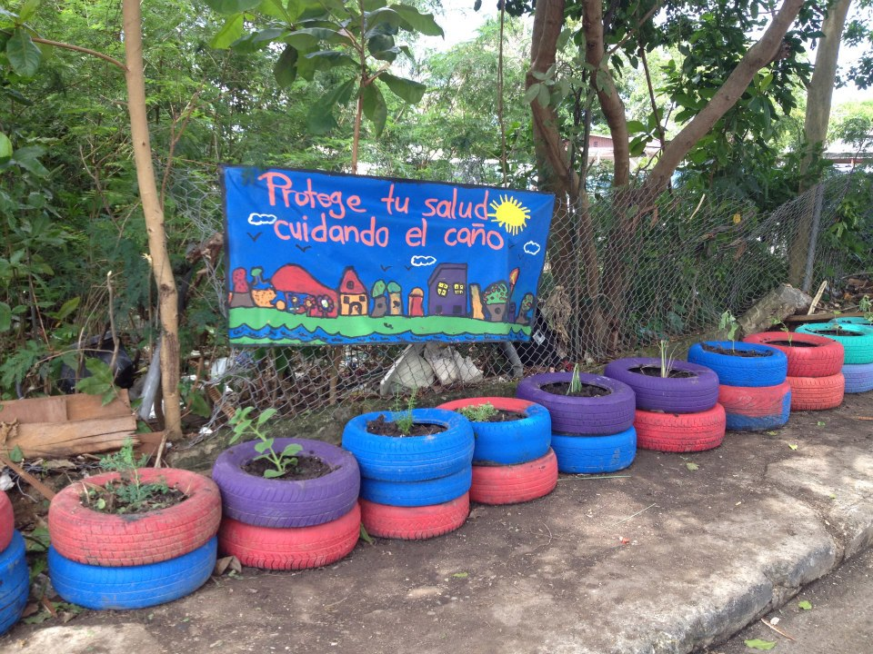
Notes:
But what are we doing to prevent trash to keep on clogging the Martín Peña Channel? We are organizing

Slide 16

Notes:
And rescuing abandoned lots and what used to be illegal landfills.

Slide 17
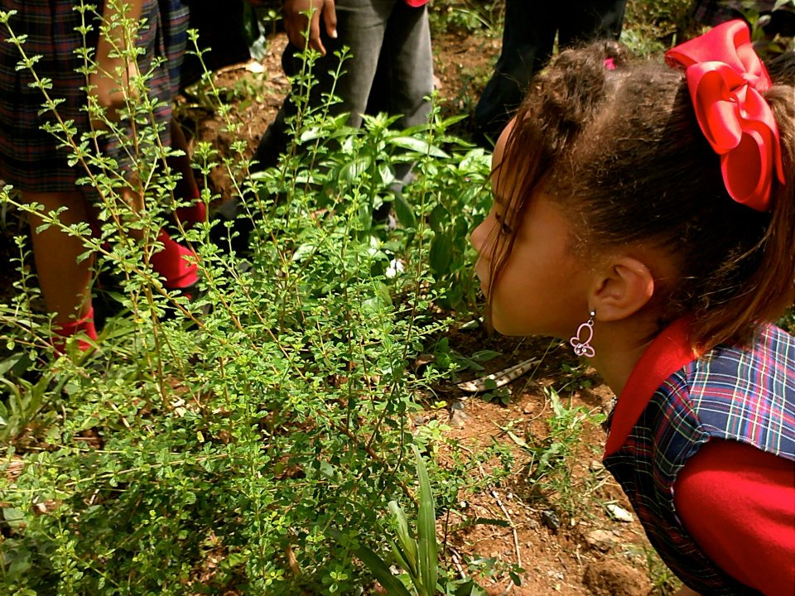
20-21% of our youth don’t finish high school
48% in communities under poverty level

Slide 18
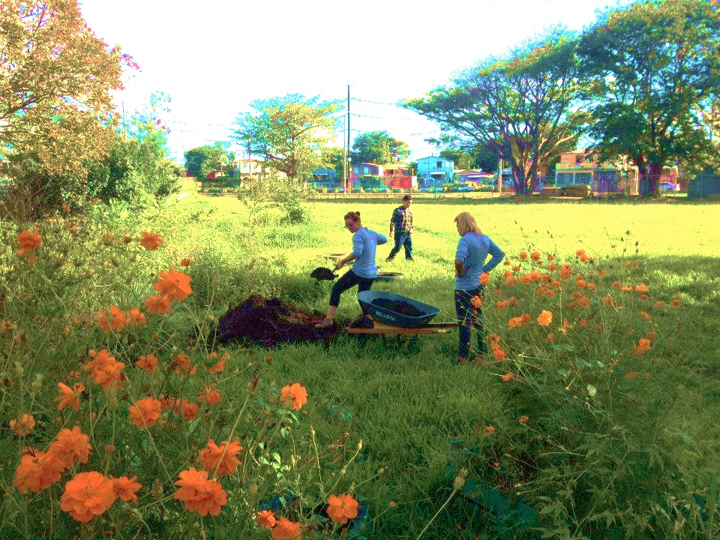
Agroecologia
comunidad
Huertos y jardines
escuelas
Notes:
So our proposal is to transform community through agroecology.

Slide 19
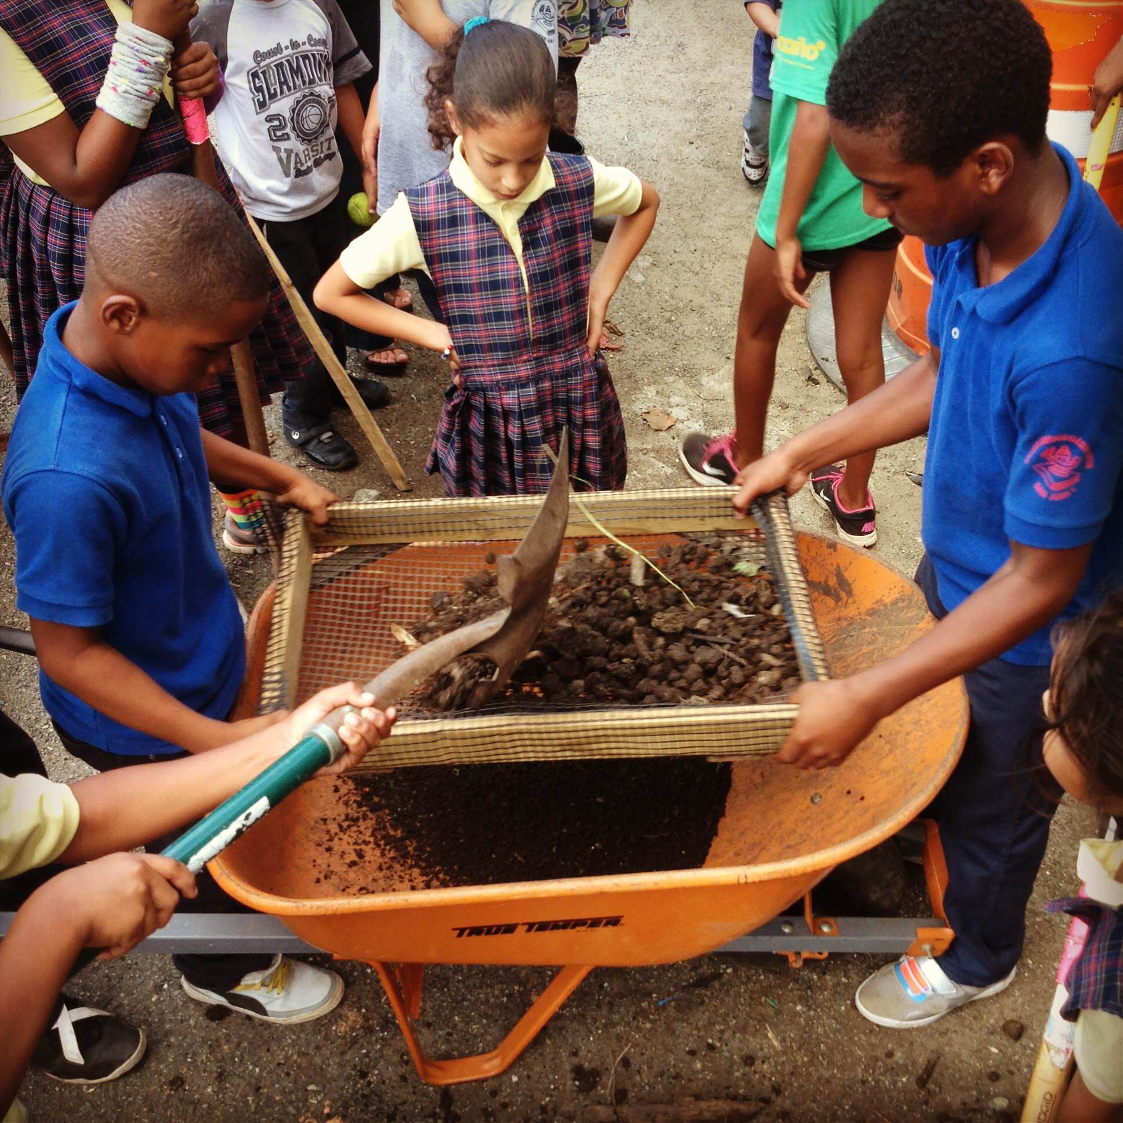
Educacion ambiental en escuelas :
Patrulleros del Ambiente
EDRA- Estudiantes Dispuestos a la Restauración Ambiental
8 programas en escuelas elementales del distritoelementary.
Educacion ambiental en dos escuelas intermedias y una superior del distrito
Logrs : ventas de productos,viaje a mexico para presentar nuestro trabajo , premio de la EPA Environmental Quality Awards.
EDRA
Recycle
Monitoreo de agua y aves
Jardines y reforestacion
Environmental awareness: Chronicles Cano, film forums, environmental documentation.
Notes:
We set up two environmental education programms withtin the Martín Peña Channel district. Patrulleros del Ambiente forthe eight elementary schools in the district were we do solid waste management, vegetable gardens, murals, environmental advocacy and develop leadership within the children. And EDRA, were we are, the name in itself was decided among all of the group! We do gardens, water monitoring, environmental advocacy and have many projects.

Slide 20
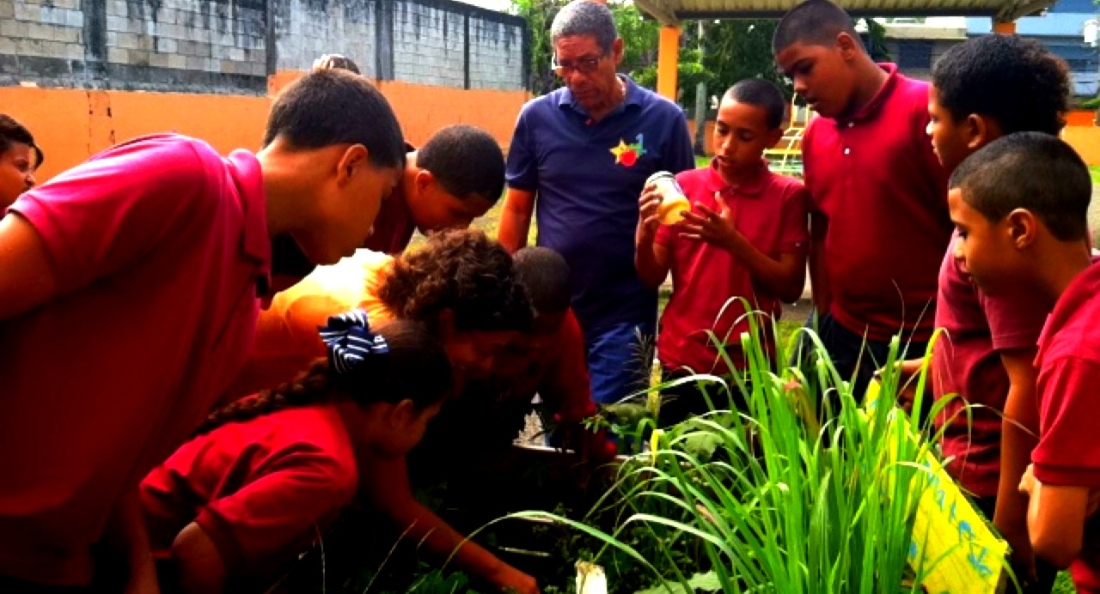
Salones de claces
Notes:
So were do we start! Well the vegetable gardens are our classroom and our hubs, from there everything else originates.

Slide 21
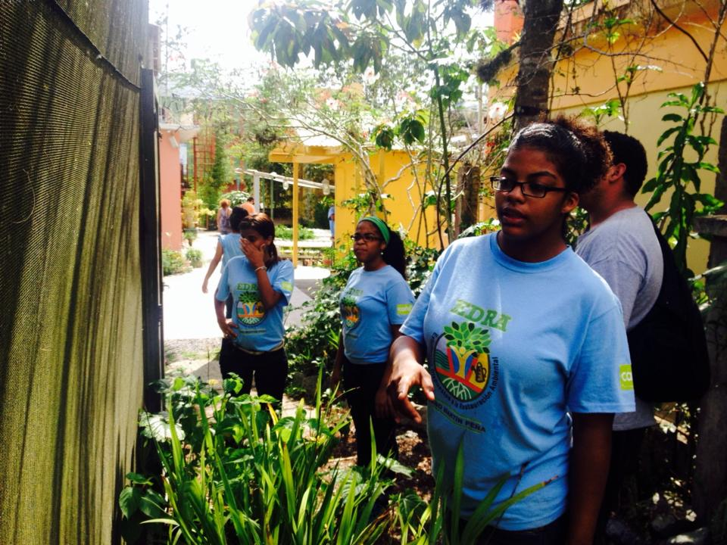
Reconectamos
Notes:
They help us reconnect with our surroundings. This picture is from another school garden in Río Piedras.

Slide 22
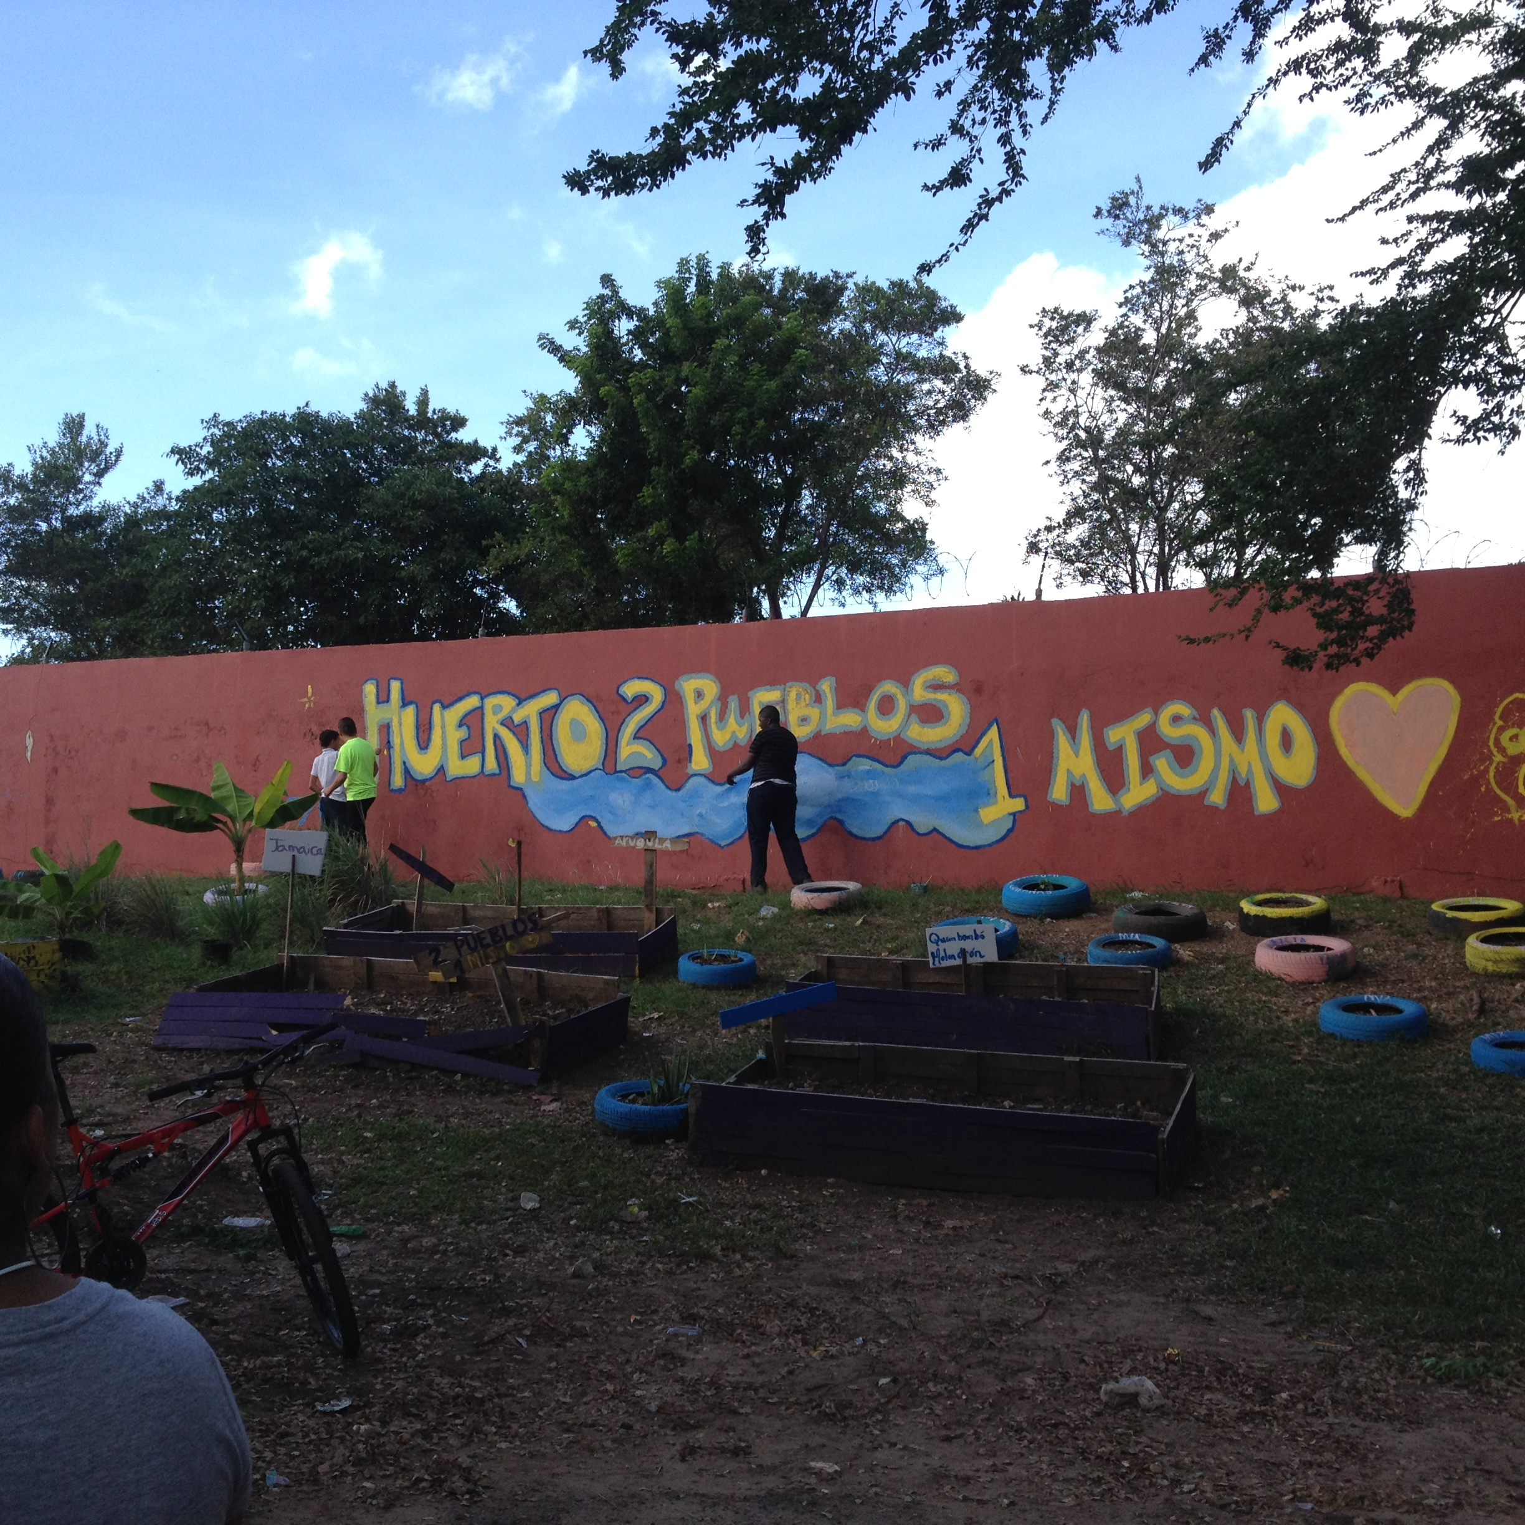
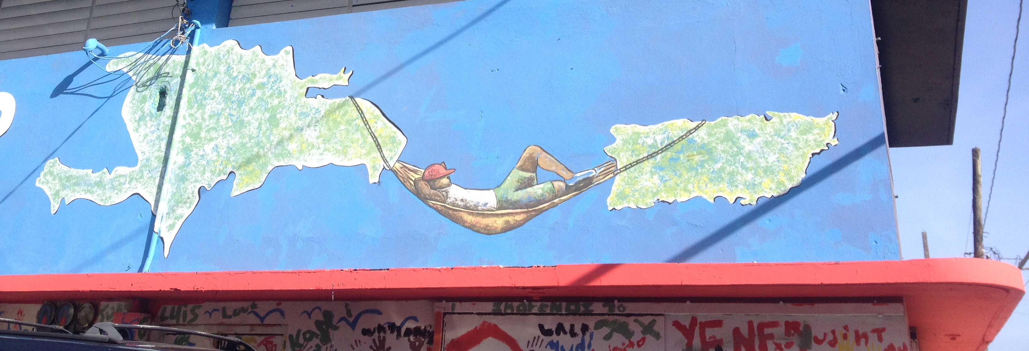
Promotes cultural exchange and tolerance

Slide 23
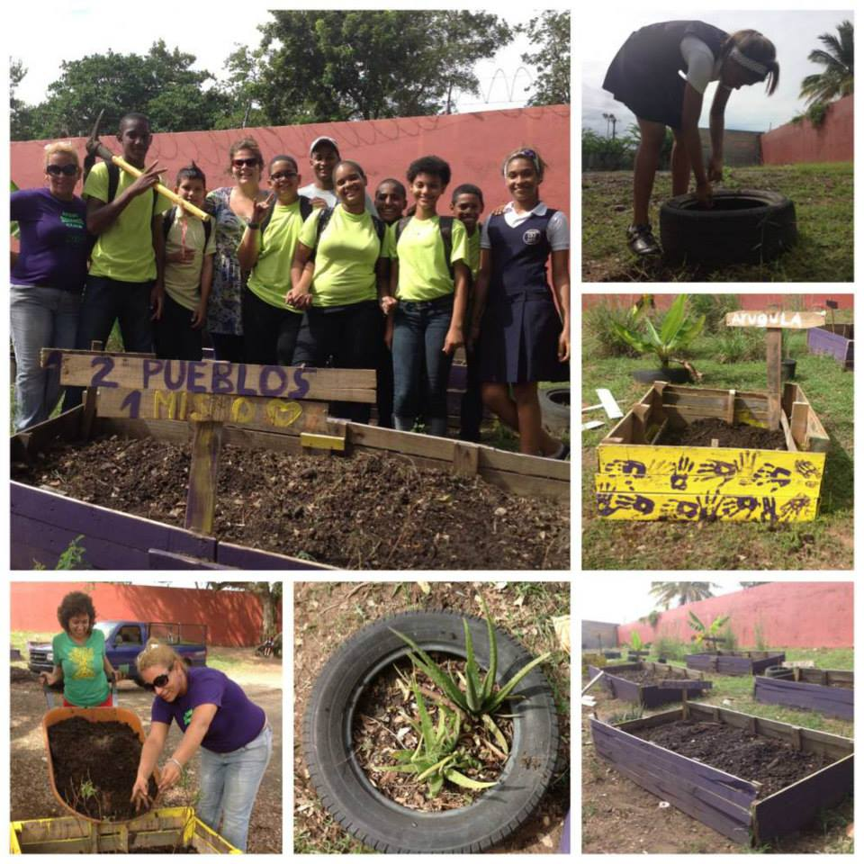
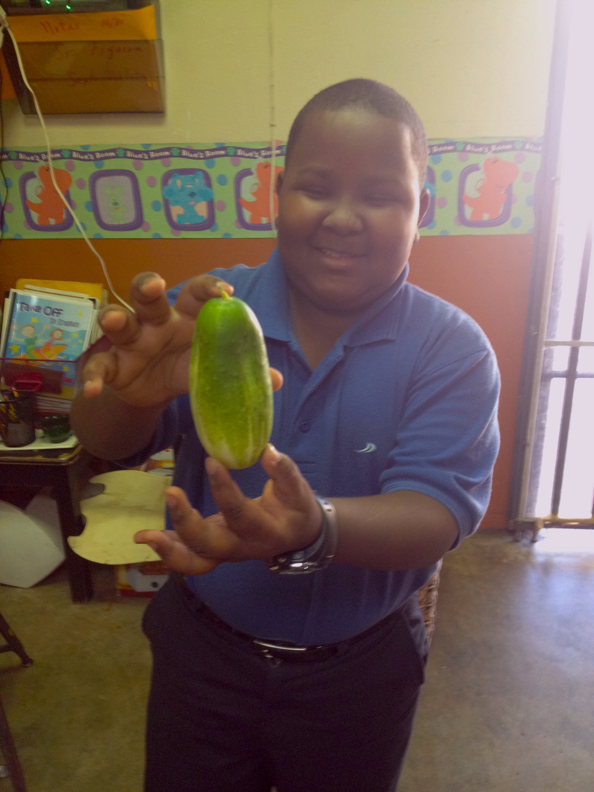
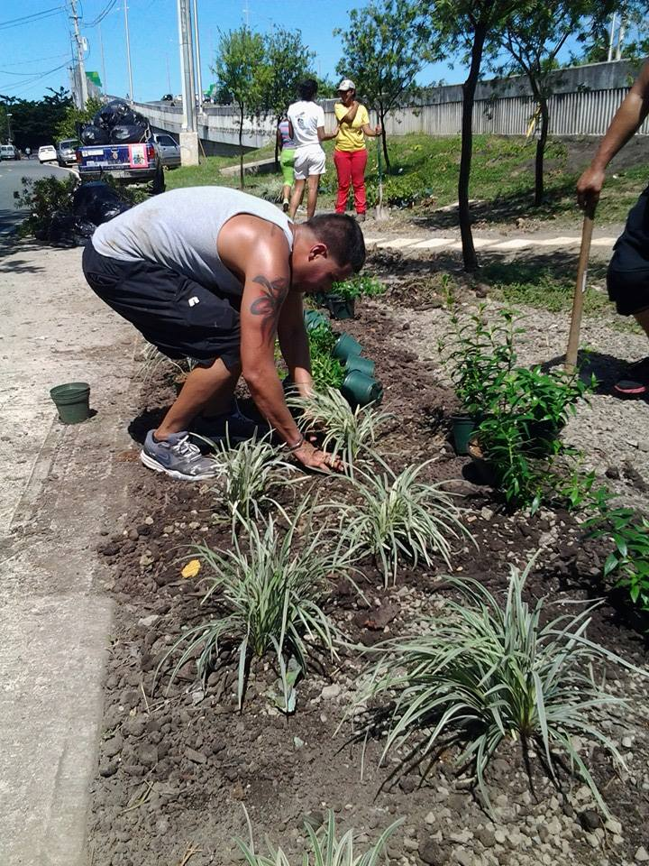
dan sentido de comunidad

Slide 24
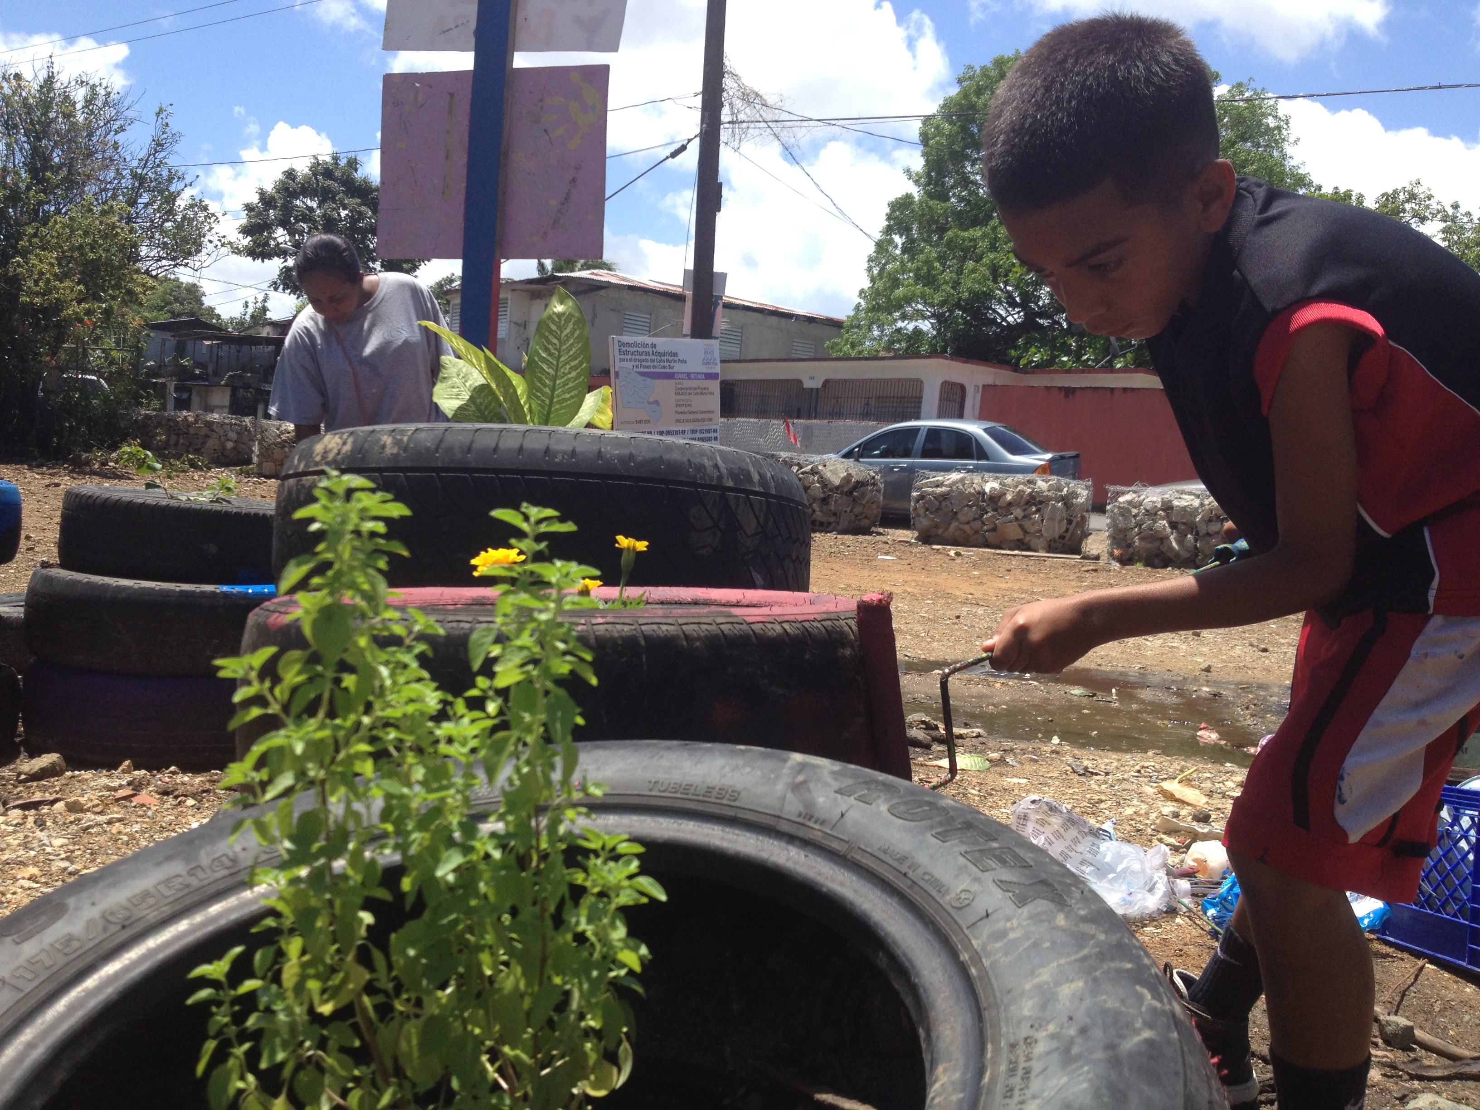
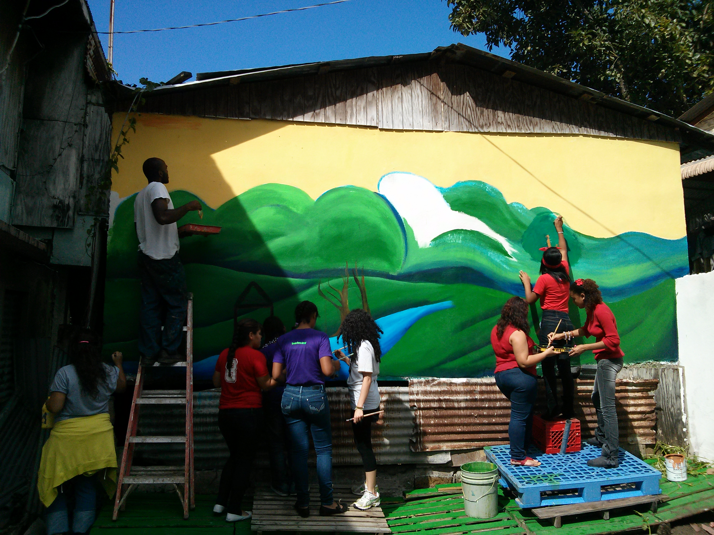
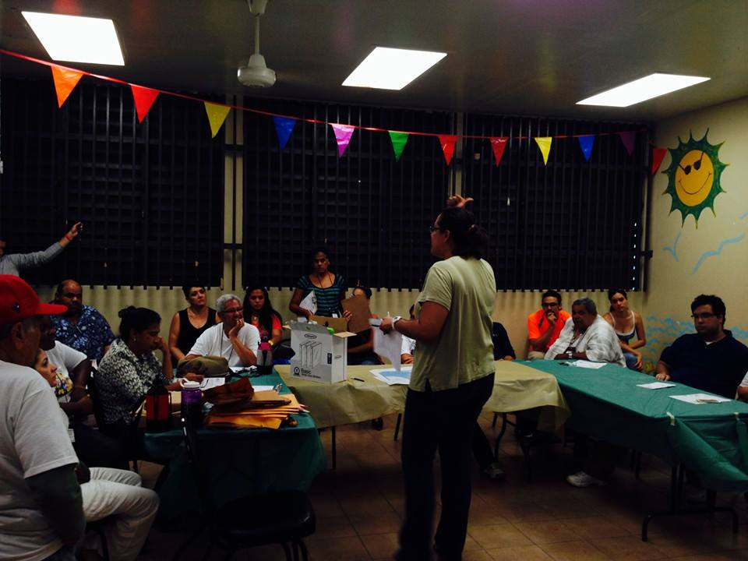
Environmental education in community:
REMEN
Solares vacantes
Comine ambiental
murales
Promotores de salud

Slide 25
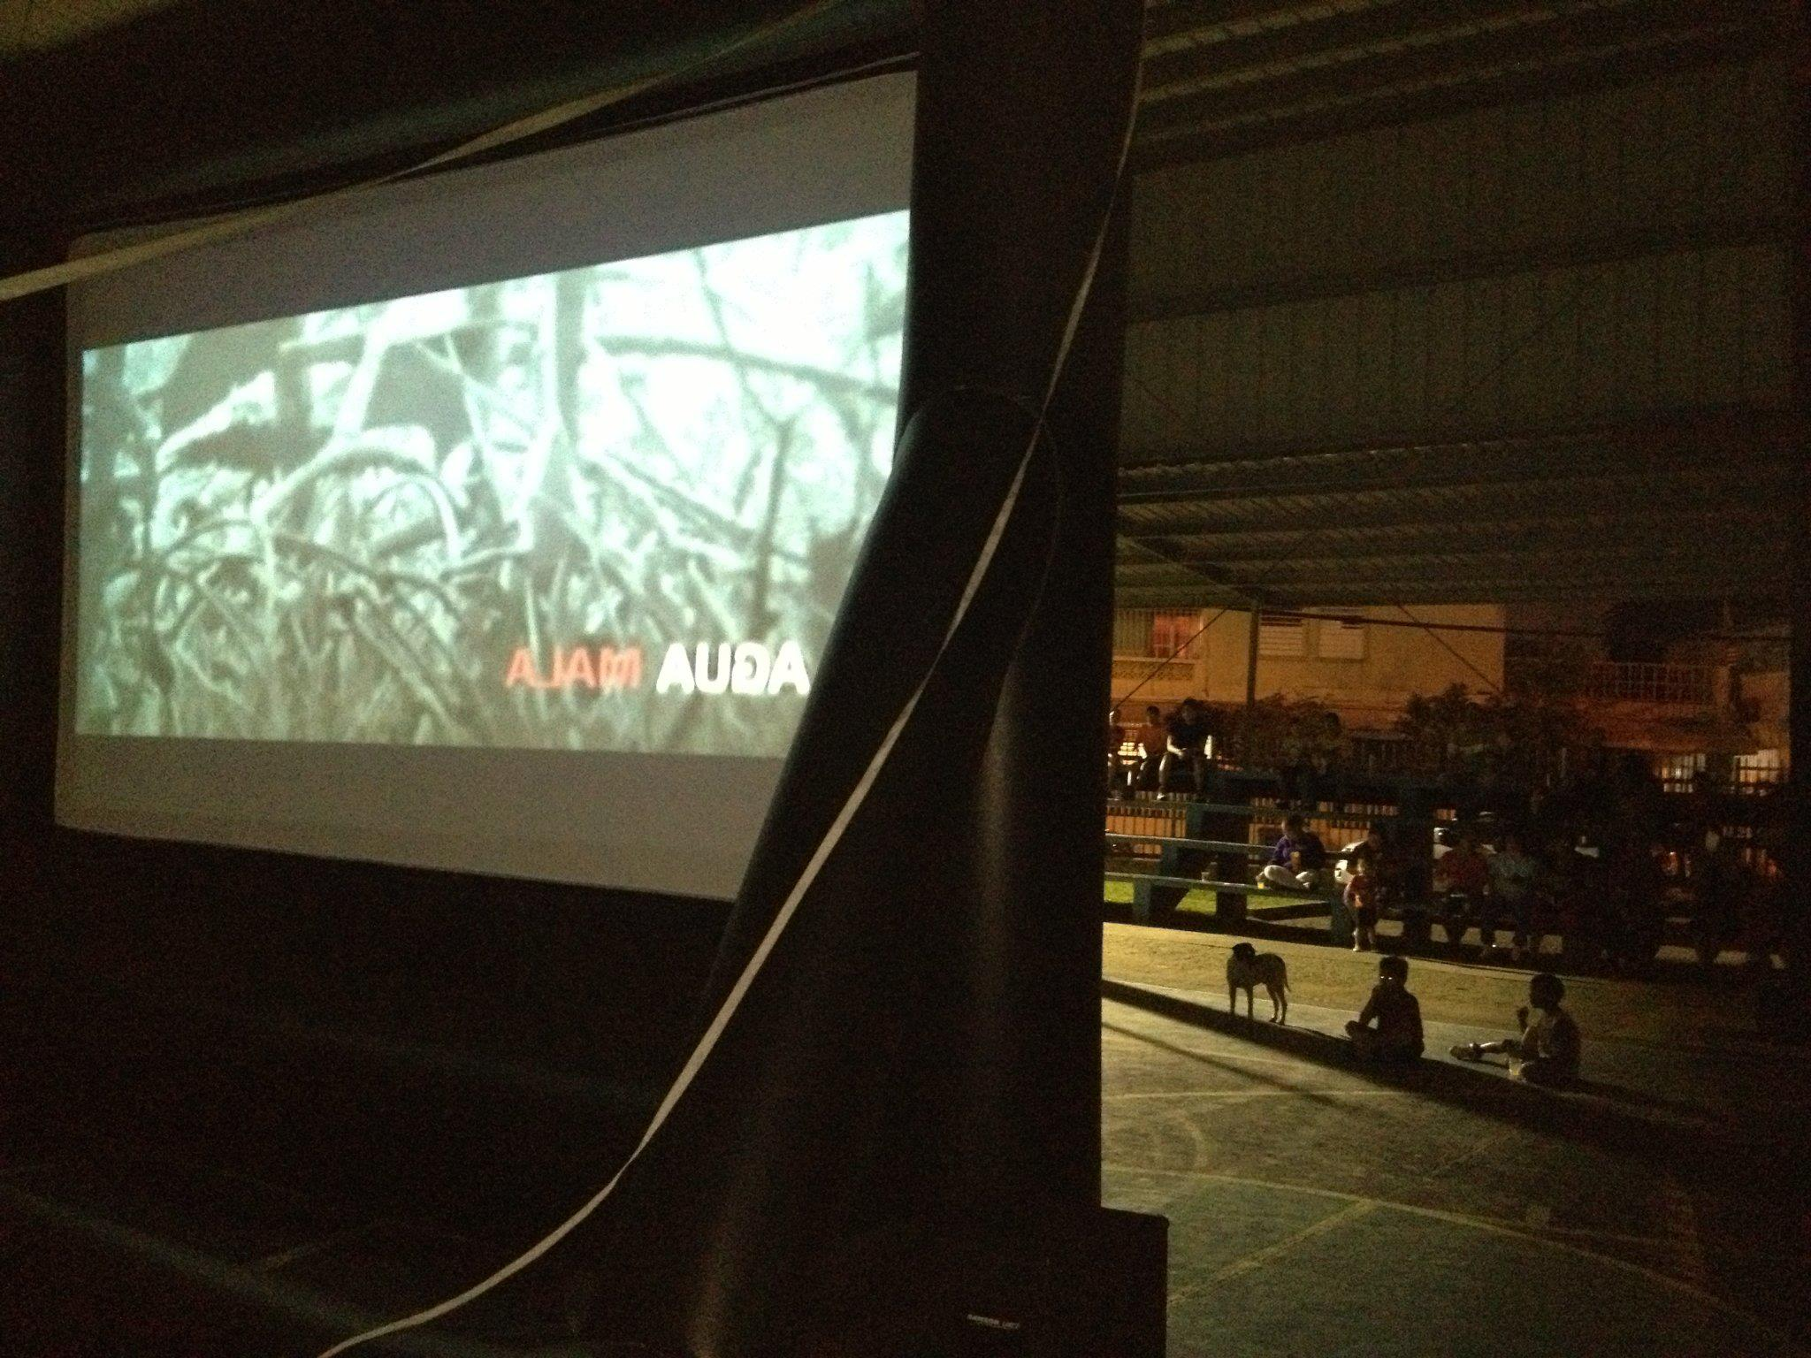
Foros de peliculas

Slide 26


Huertos del Caño
Huertos Escolares
Huertos Comunitarios
EDRA
Huerto El Edén, Escuela Superior Albert Einstein
Huerto Dos Pueblos Un Mismo Corazón, Escuela Intermedia Ramos Antonini
Nuestro Huerto, Escuela Intermedia Federico Asenjo
Patrulleros del Ambiente
Super Huerto Corazón de la Paz, Escuela Elemental Emilio del Toro y Cuebas
Huerto Martín Peña, Escuela Elemental Jaime Rosario Baez
Huerto Santiago Iglesias Pantín, Escuela Elemental Santiago Iglesias Pantín
Huerto Ecológico Comunitario Las Monjas y Buena Vista Hato Rey
Huerto Comunitario El Pilar
Huerto Comunitario Israel y Bitumul
Huerto El Bohío, Buena Vista Santurce
Solares impactados y jardines
Entrada, Solar 1, Solar 2 (huerto Edwincito) Israel y Bitumul
Calle 1 Buena Vista Santurce
Debajo del puente Buena Vista Santurce
Jardín Parque y calle Prudencio, Las Monjas
Entrada a calle 15 – Eric

Slide 27
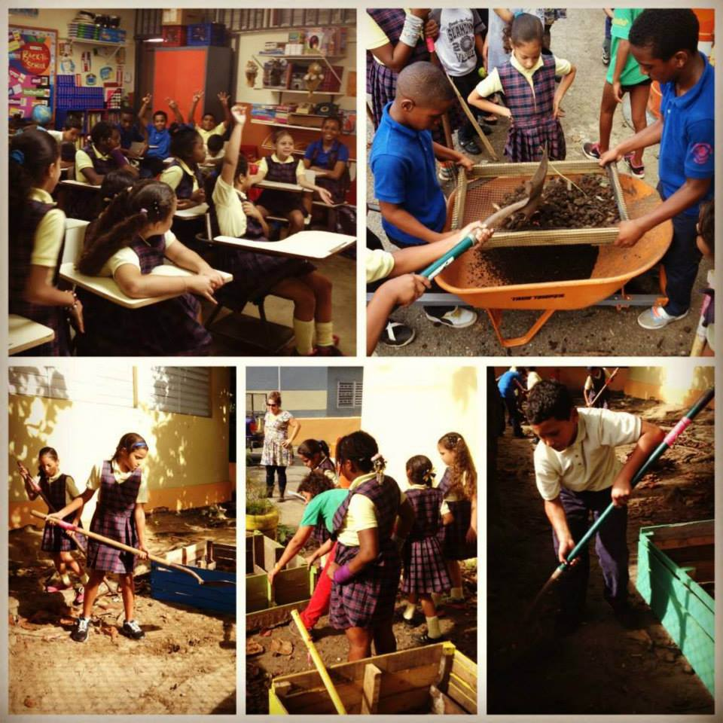
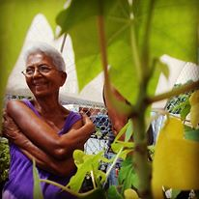
Exchange Knowledge

Slide 28
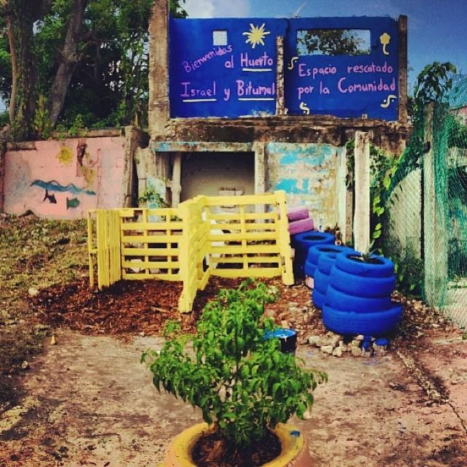

Slide 29
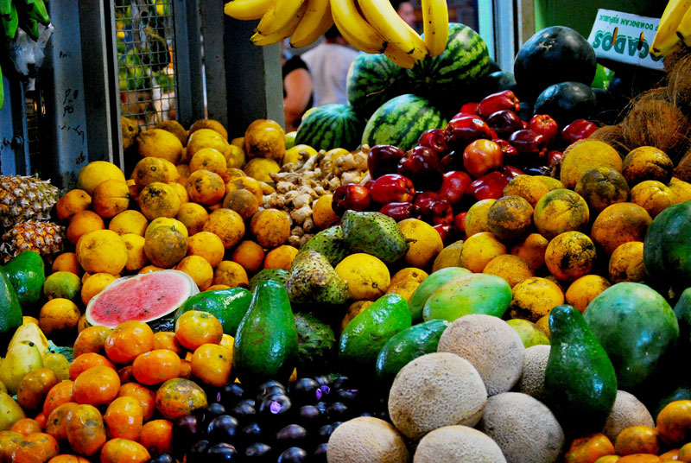
Costa Rica
Puerto Rico
República Dominicana
Florida
México
Foto: http://www.boriken365.com/
Notes:
Over half of the food is imported.

Slide 30
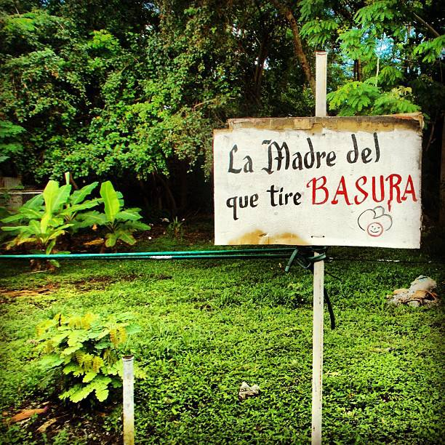
Notes:
Besides rescuing spaces we are also producing food for Puerto Rico and our communities in a larger context

Slide 31
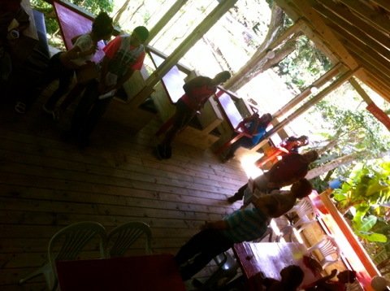
Students assess needs for local markets and farmers (survey)

Slide 32
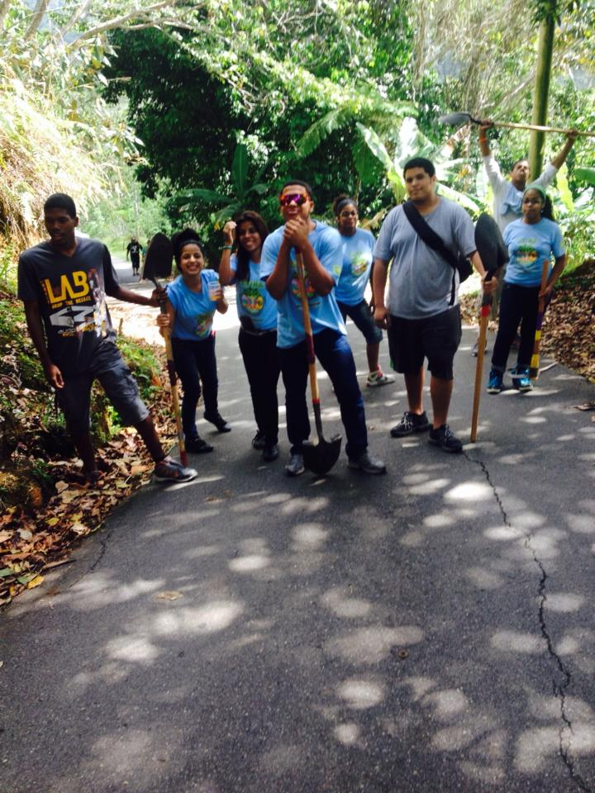
Helping reforestation

Slide 33

actividades

Slide 34



Proveemos herramientas para los proyectos

Slide 35


Slide 36

brigadas

Slide 37

Notes:
Harvesting lettuce in school Dr. Albert Einstein.

Slide 38

Notes:
Students integrate with their teachers to help harvest the garden.

Slide 39

Mesas de ventas

Slide 40

Notes:
This is one of the creations with our harvest.

Slide 41

Notes:
EDRA in the festival of the Tinglar.

Slide 42

Notes:
EDRA wins EPA award

Slide 43


Slide 44

Notes:
Interview with one of the participants of EDRA.

Slide 45

Provide basic infrastructure (commercially, water collection, seeds, greenhouse) and capacity building in farming communities.
Farmer to Farmer
Campesino a Campesino
Paysan Paysan

Slide 46

Notes:
EDRA Two students traveled to Mexico.

