Slide 1
EPA FUNDING OPPORTUNITIES
Brenda Reyes Tomassini
Public Affairs Specialist
Caribbean Environmental Protection Division
US EPA Region 2

Slide 2
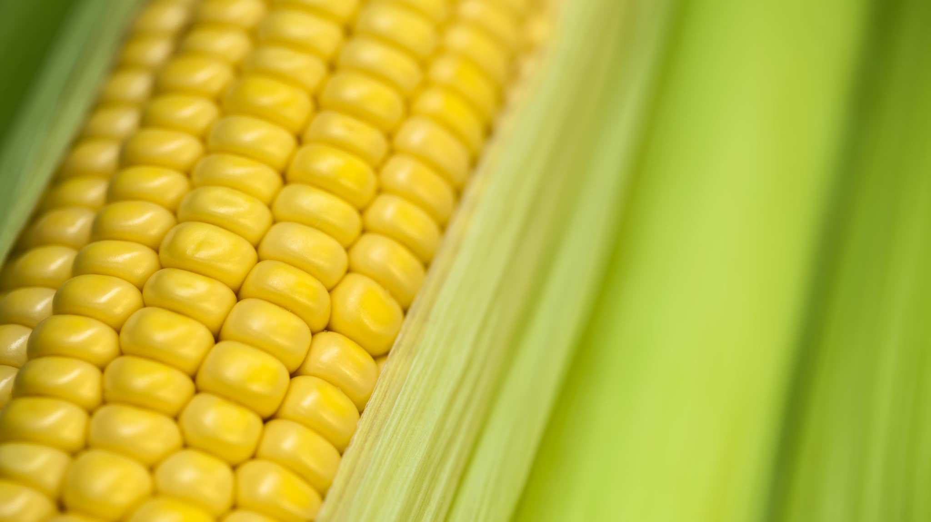
RFA: SUPPORTING ANAEROBIC DIGESTION IN COMMUNITIES
Anaerobic digestion (AD) is the natural process in which microorganisms break down organic (plant and animal) materials. Food waste diverted from landfills and incinerators can be managed at AD facilities. The AD process generates renewable energy (biogas) and a product that can improve soil health (digestate). Food waste AD reduces landfill methane emissions.
The goal of this funding opportunity is to increase the use of AD to manage food waste. Another goal is to support the development of new AD infrastructure in the U.S.

Slide 3
RFA: SUPPORTING ANAEROBIC DIGESTION IN COMMUNITIES
Funds for the development of new or enhance/increase existing anaerobic supports the priorities detailed in President Biden’s Executive Order 13985 titled Advancing Racial Equity and Support for Underserved Communities Through the Federal Government and Executive Order 14008 titled Tackling the Climate Crisis at Home and Abroad.
EPA anticipates awarding approximately one to two grants per EPA region in amounts ranging from $50,000 - $200,000 per award. Applicants should plan for projects to begin on February 1, 2022.

Slide 4
EPA strongly encourages all eligible applicants identified, including minority serving institutions (MSIs), to apply under this opportunity. For purposes of this solicitation. ALL COLLEGES AND UNIVERSITIES IN PUERTO RICO QUALIFY under this category. Please see the RFA.
The closing date and time for receipt of application submissions is October 7, 2021

Slide 5
Other EPA Grant Opportunities
EPA’s Small Business Innovation Research (SBIR) Phase I Solicitation, EPA Regional Grants and Technical Assistance Programs such as Local Food, Local Places.
Other federal agencies such as USDA and DOE
Please visit:
https://www.epa.gov/land-research/food-waste-research
https://www.epa.gov/sustainable-management-food/funding-opportunities-and-epa-programs-related-food-system#EPAgrants

Slide 6
Contact Information
Brenda Reyes Tomassini
eyes.brenda@epa.gov
787-295-0087
787-977-5865

